Slide 1

Programa de Formação de Especialistas em Algoritmos e Otimização
Data Structures
https://www.coursera.org/learn/data-structures
Reunião de Tutoria: Semana 1

Slide 2
Problem 1: Check Brackets in the Code
Introduction
In this problem you will implement a feature for a text editor to find errors in the usage of brackets in the code.
Problem Description
Code can contain any brackets from the set []{}(), where the opening brackets are [,{, and ( and the closing brackets corresponding to them are ],}, and ).
For convenience, the text editor should inform the user if there is an error in the usage of brackets and point to the exact place in the code with the problematic bracket.
Input Format
Input contains one string 𝑆 which consists of big and small latin letters, digits, punctuation marks and brackets from the set []{}()
Constraints.
The length of 𝑆 is at least 1 and at most 10⁵
Output Format.
If the code in 𝑆 uses brackets correctly, output “Success" (without the quotes). Otherwise, output the 1-based index of the first unmatched closing bracket, and if there are no unmatched closing brackets, output the 1-based index of the first unmatched opening bracket

Slide 3
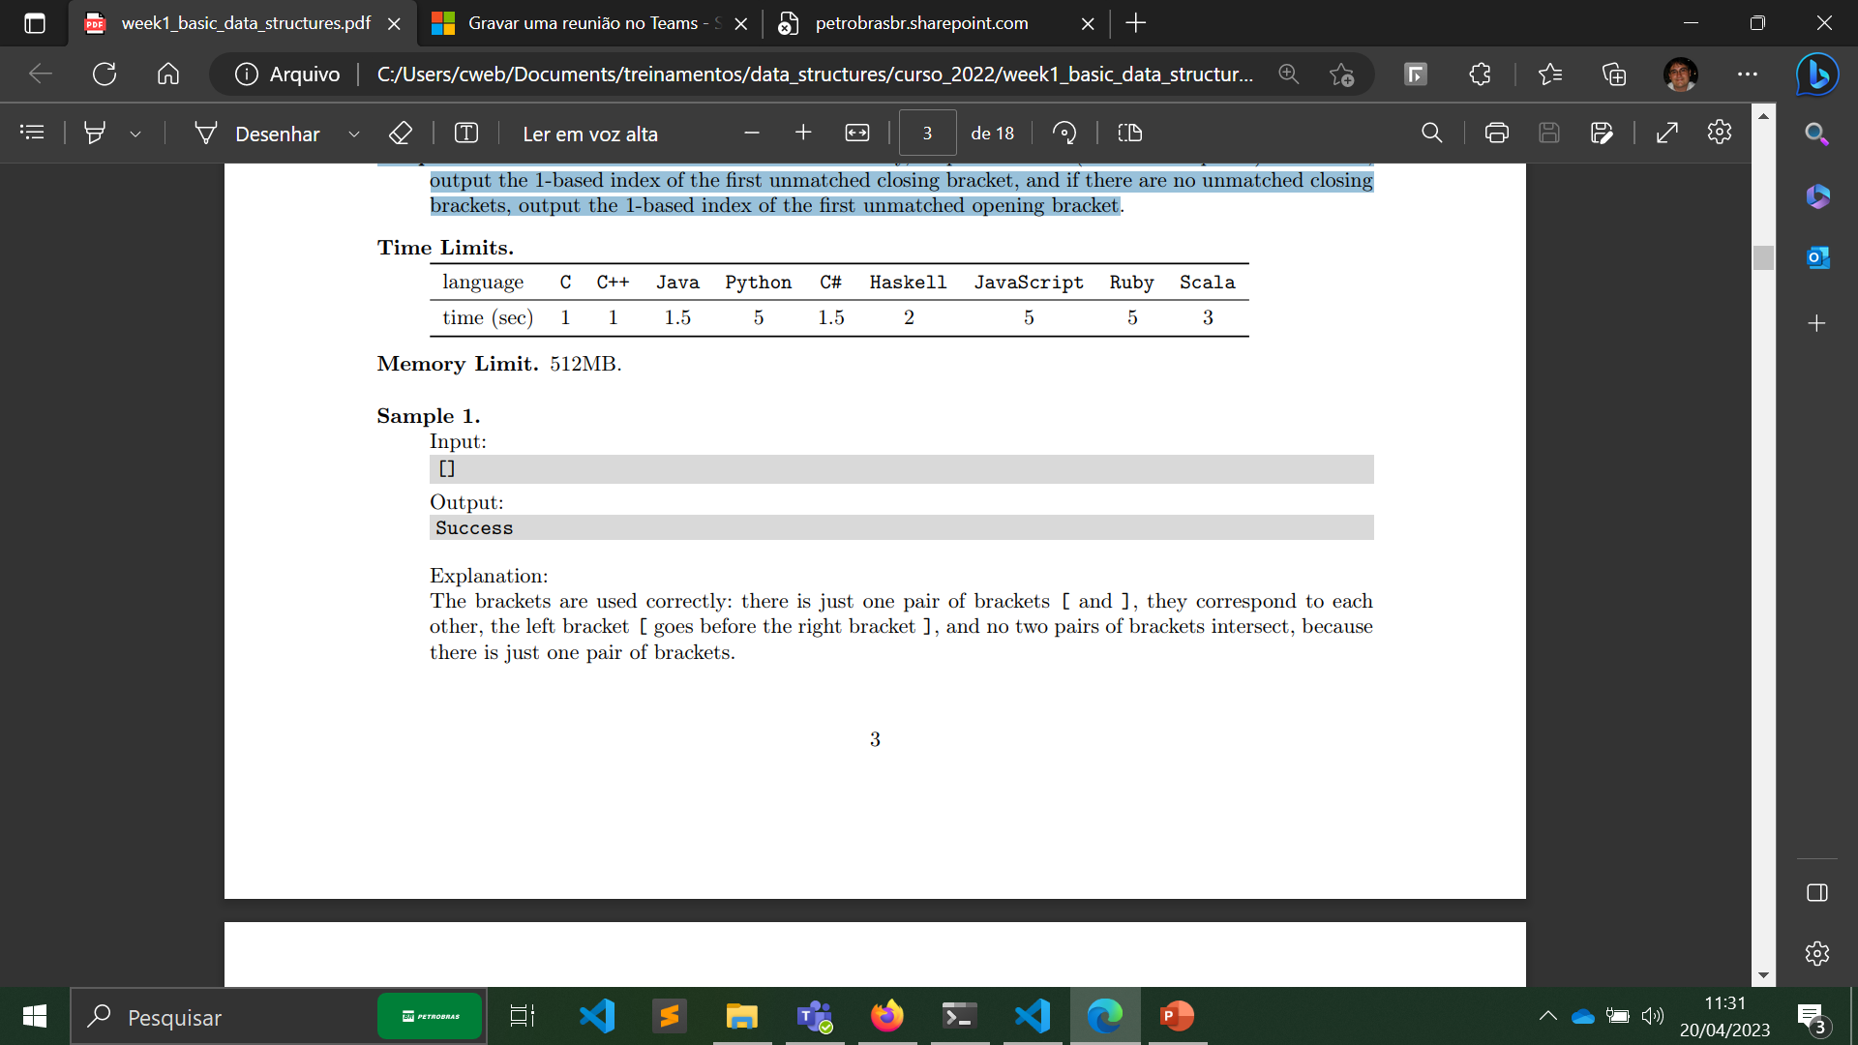
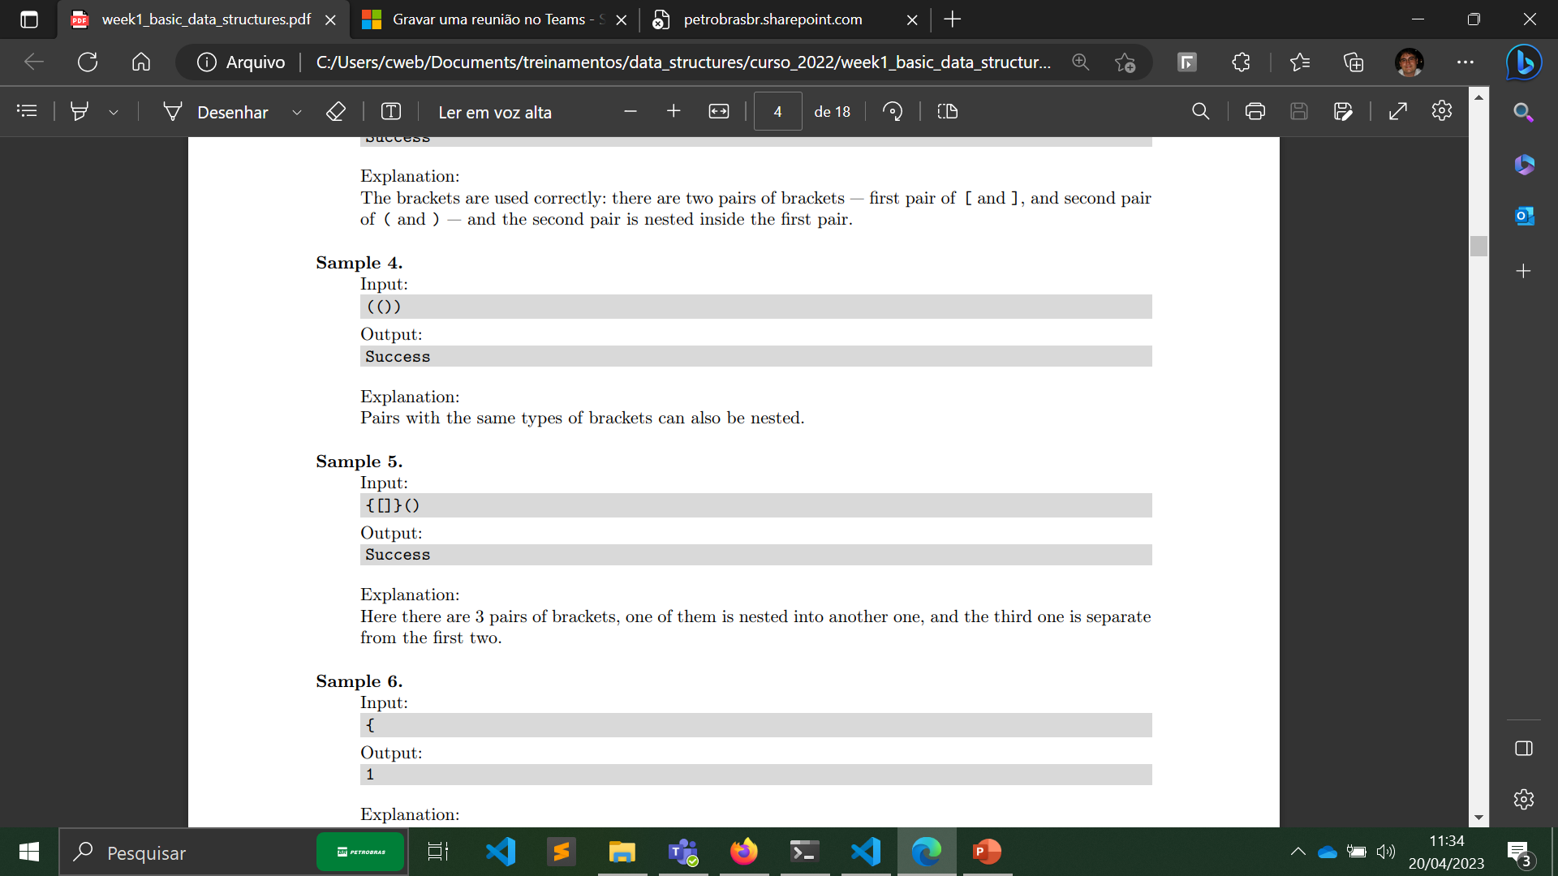
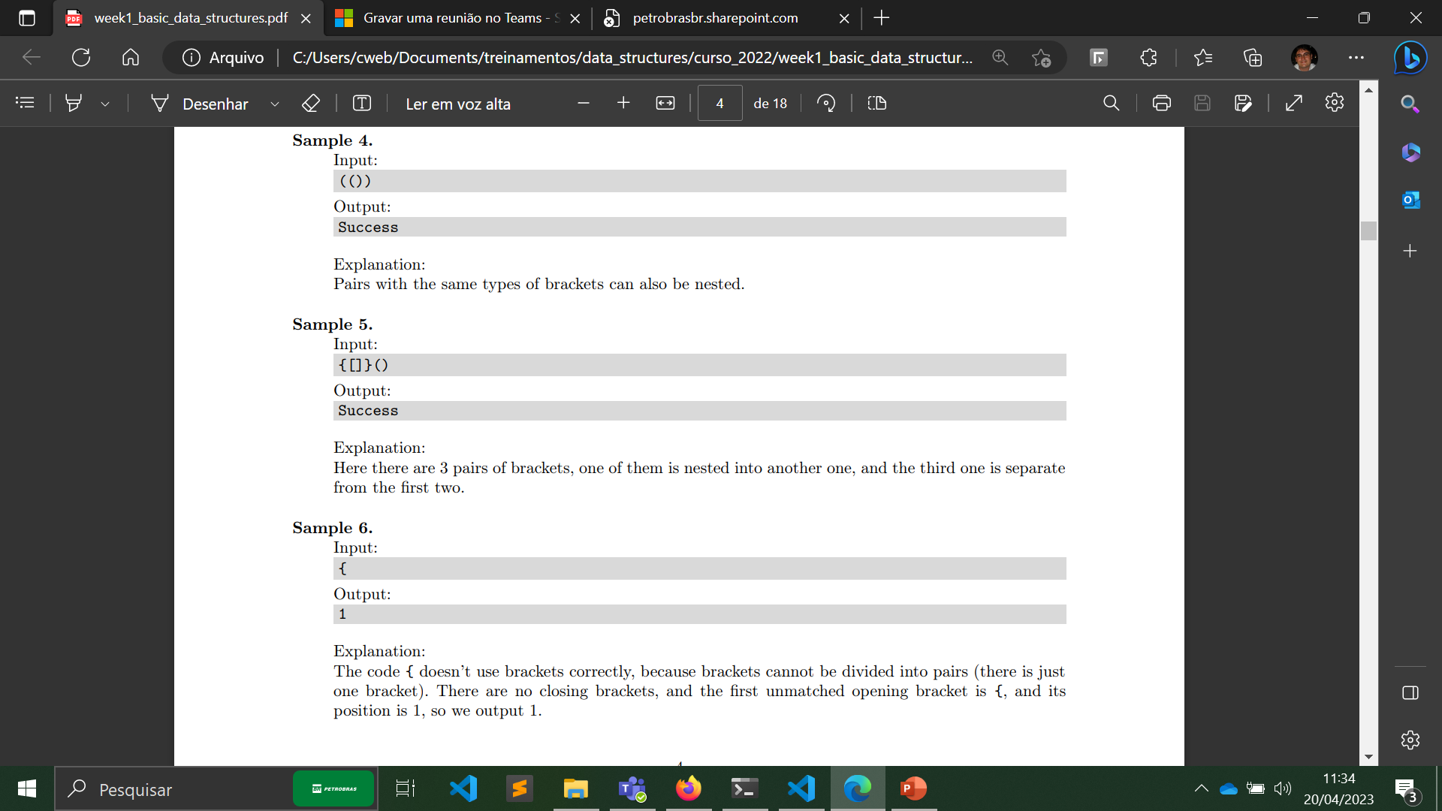
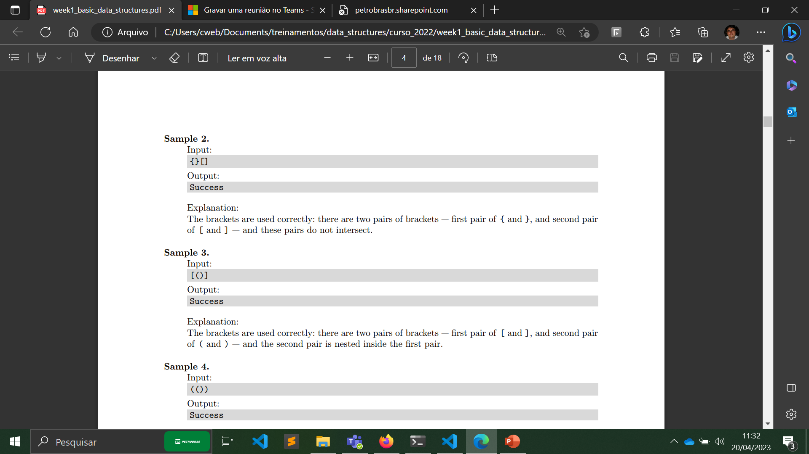
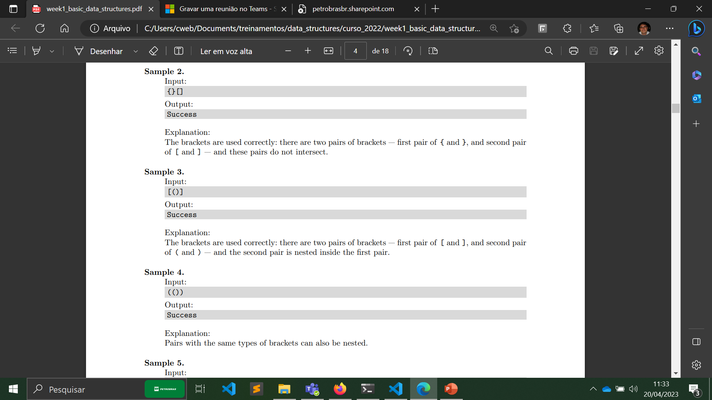
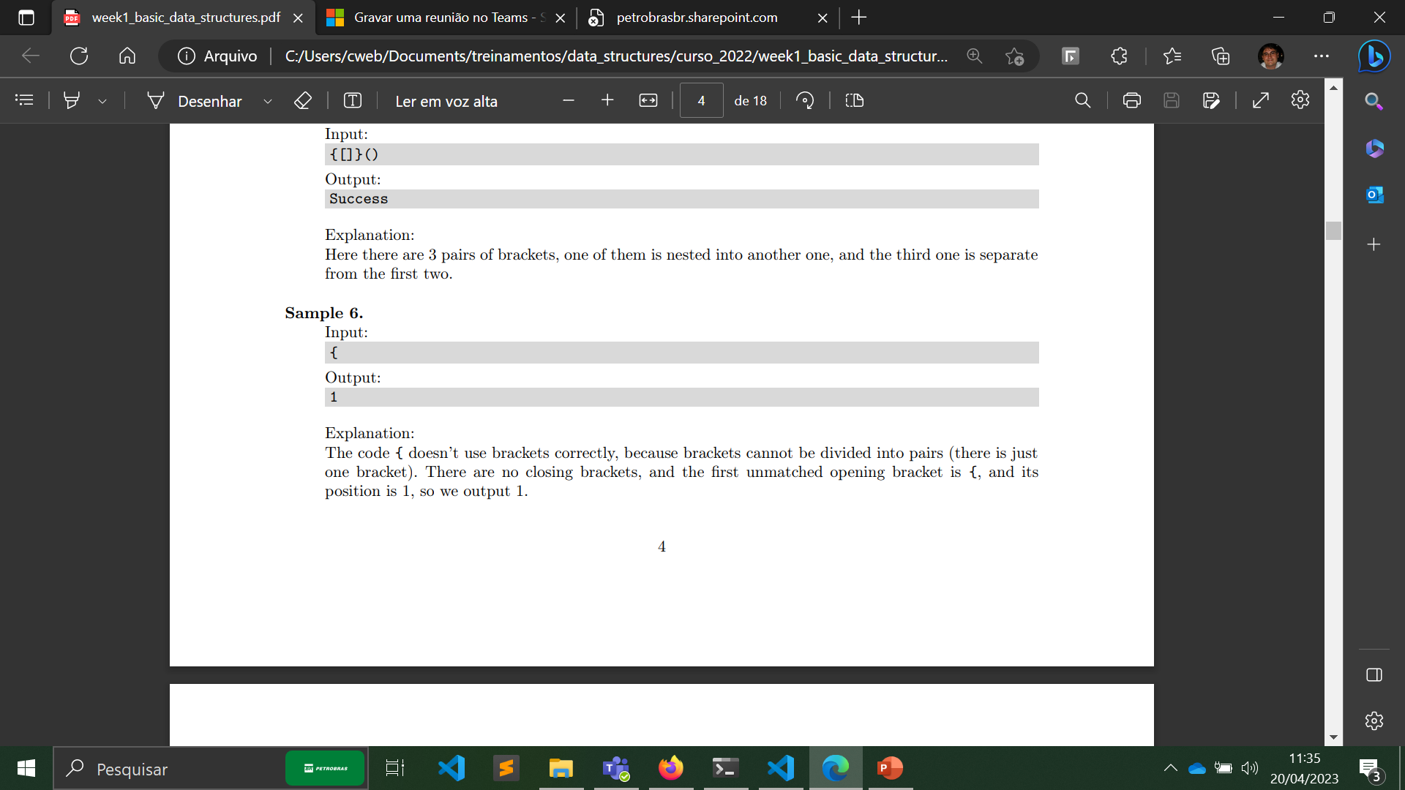
Problem 1: Check Brackets in the Code

Slide 4
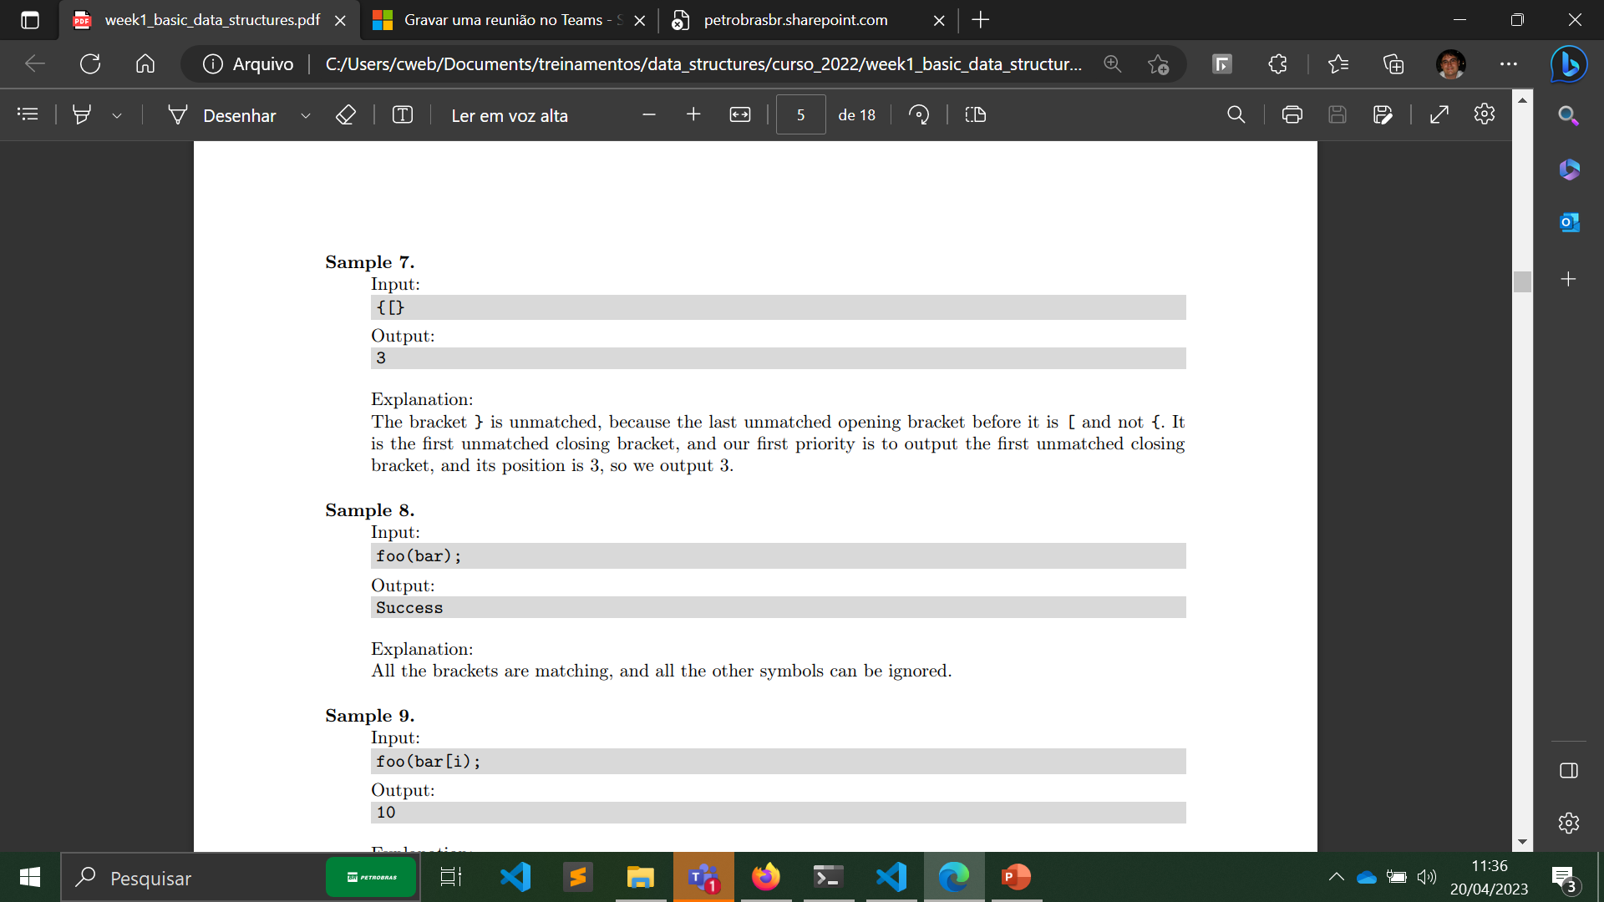
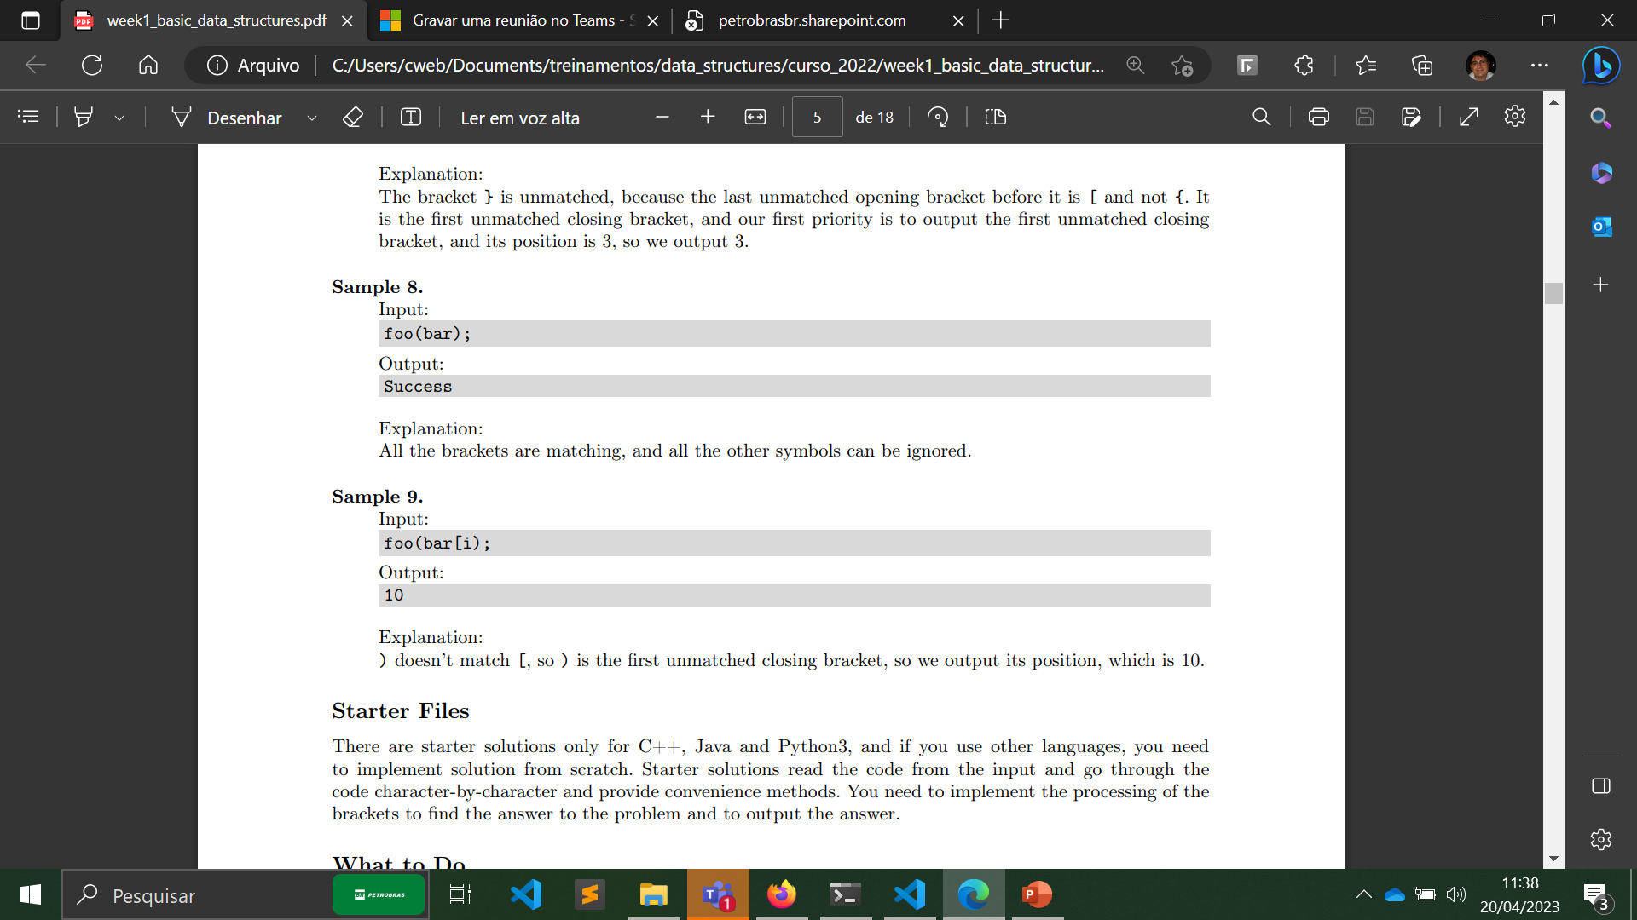

Problem 1: Check Brackets in the Code

Slide 5
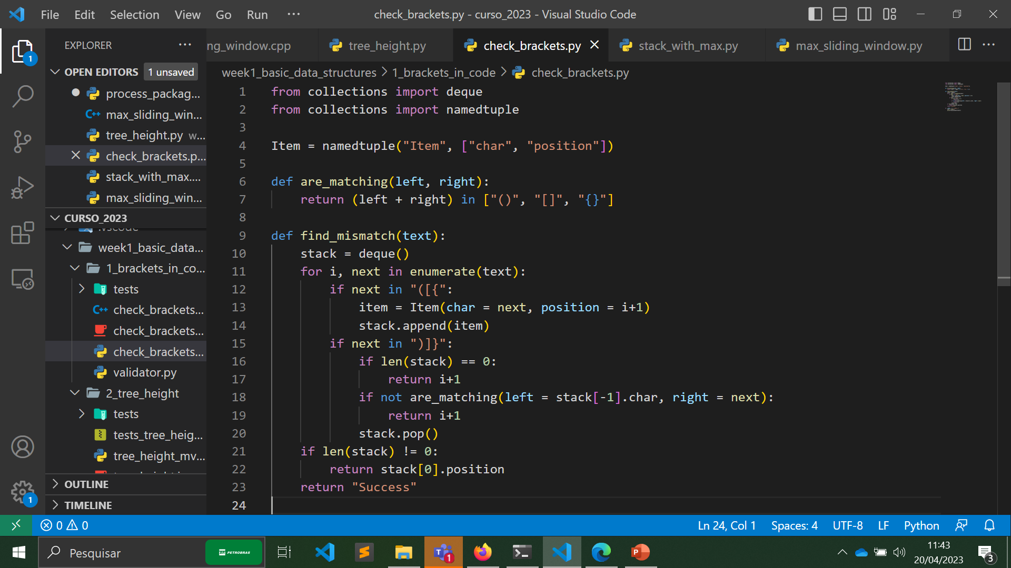
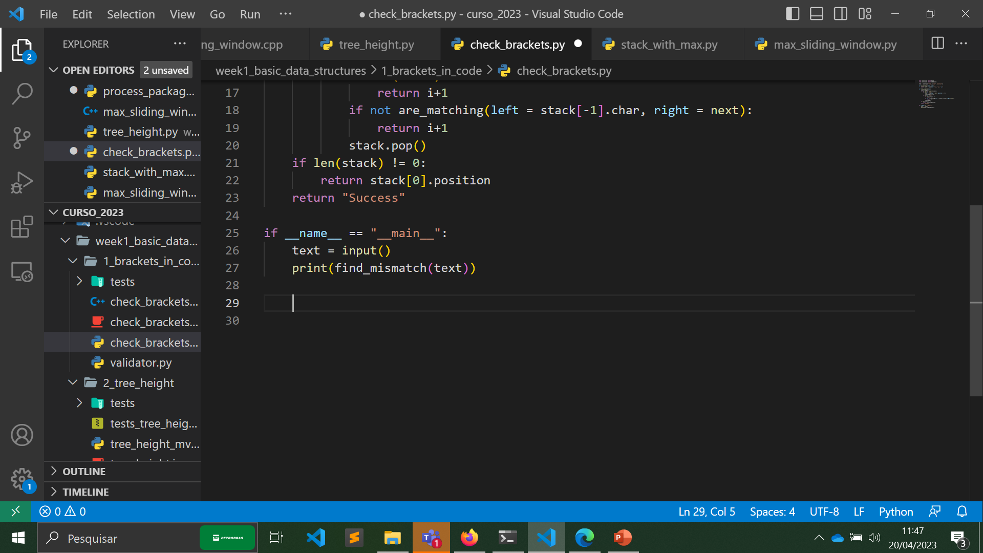
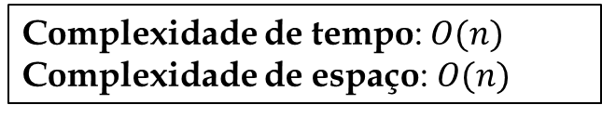
Problem 1: Check Brackets in the Code
Algoritmo
Continuação
Complexidade de tempo: $O(n)$
Complexidade de espaço: $O(n)$

Slide 6
Problem 2: Compute Tree Height
Task
You are given a description of a rooted tree. Your task is to compute and output its height. Recall that the height of a (rooted) tree is the maximum depth of a node, or the maximum distance from a leaf to the root. You are given an arbitrary tree, not necessarily a binary tree.
Input Format
The first line contains the number of nodes 𝑛. The second line contains 𝑛 integer numbers from −1 to 𝑛 − 1 — parents of nodes. If the 𝑖-th one of them (0 ≤ 𝑖 ≤ 𝑛 − 1) is −1, node 𝑖 is the root, otherwise it’s 0-based index of the parent of 𝑖-th node. It is guaranteed that there is exactly one root. It is guaranteed that the input represents a tree.
Constraints
1 ≤ 𝑛 ≤ 10⁵
Output Format
Output the height of the tree.

Slide 7
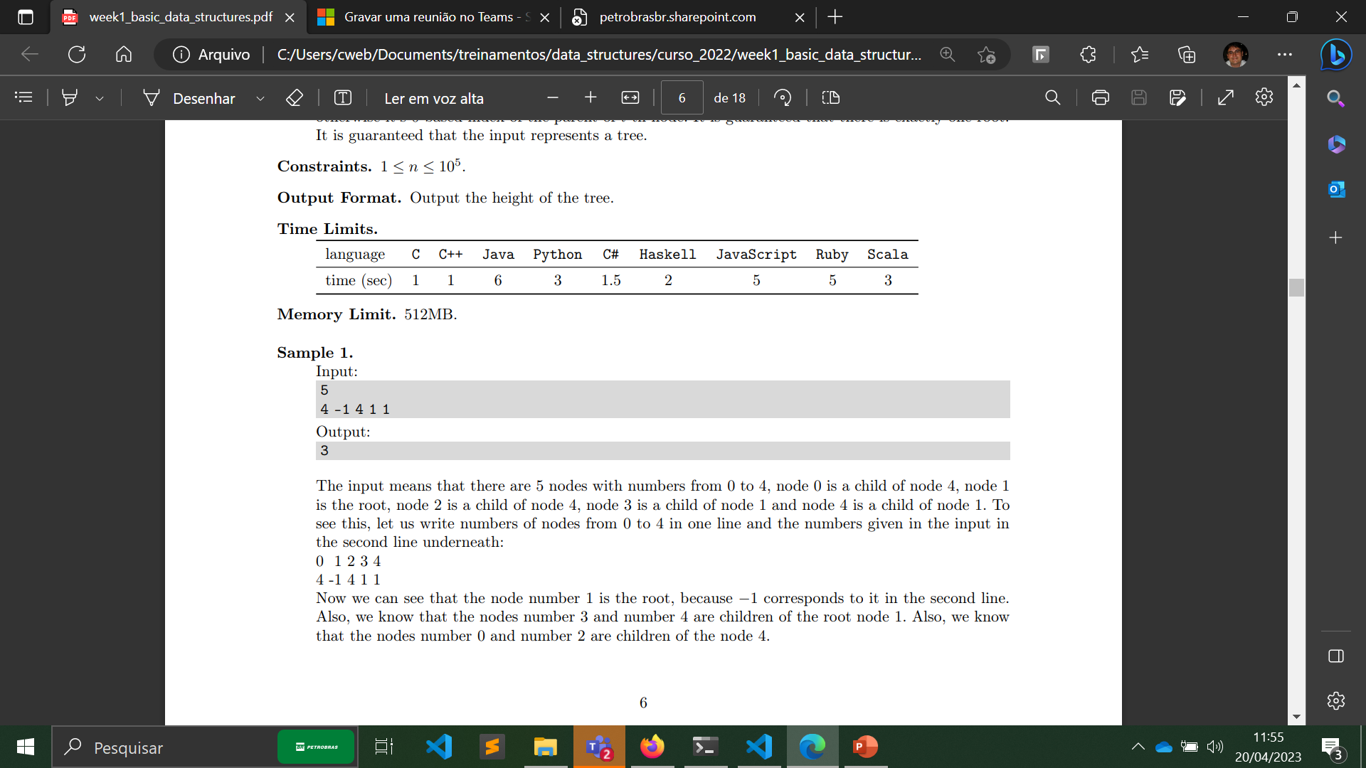
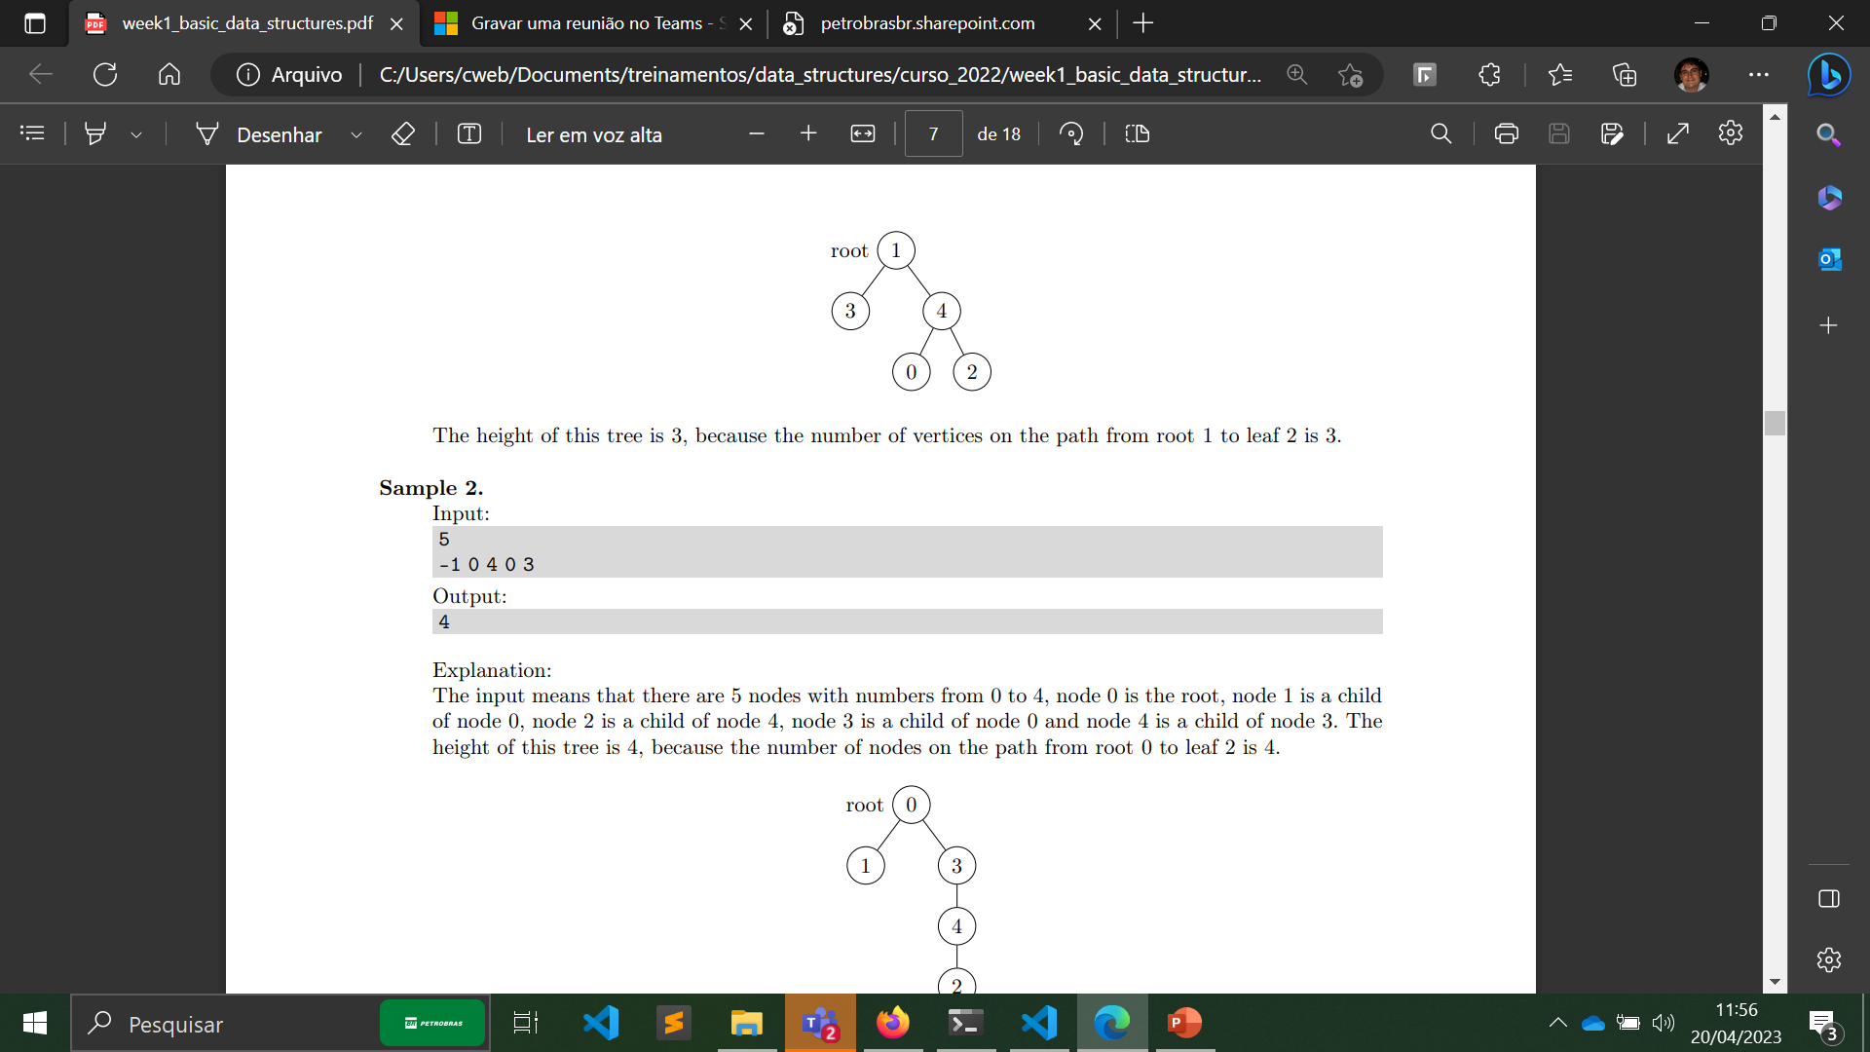
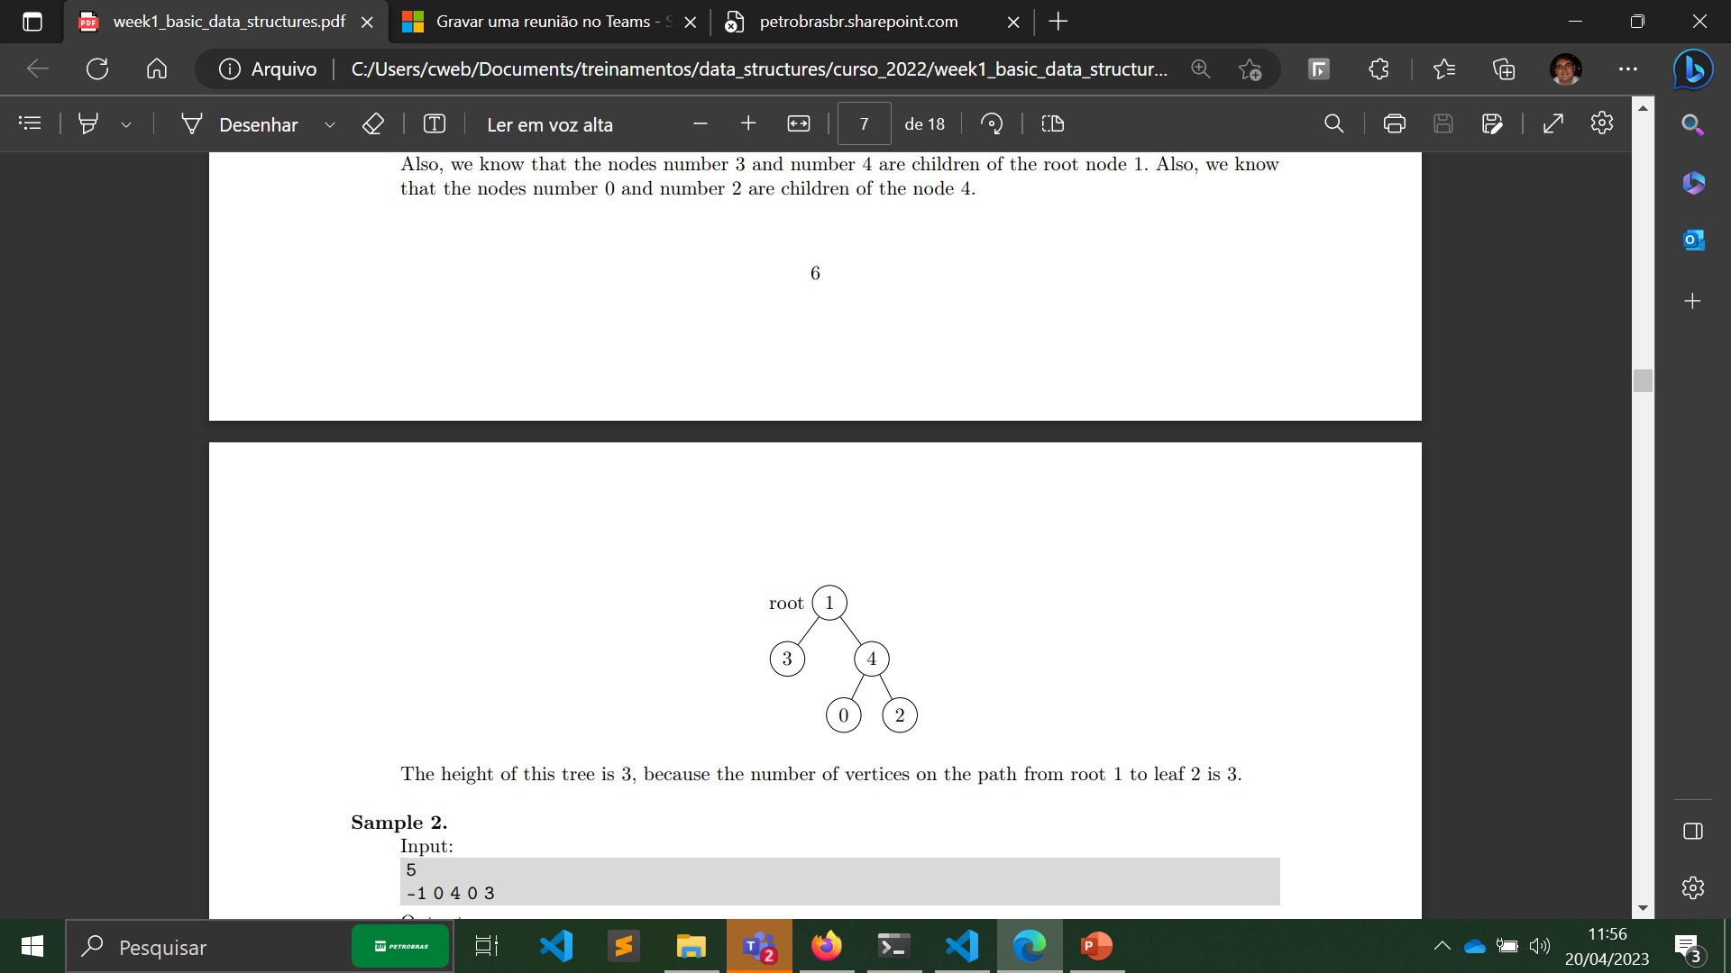
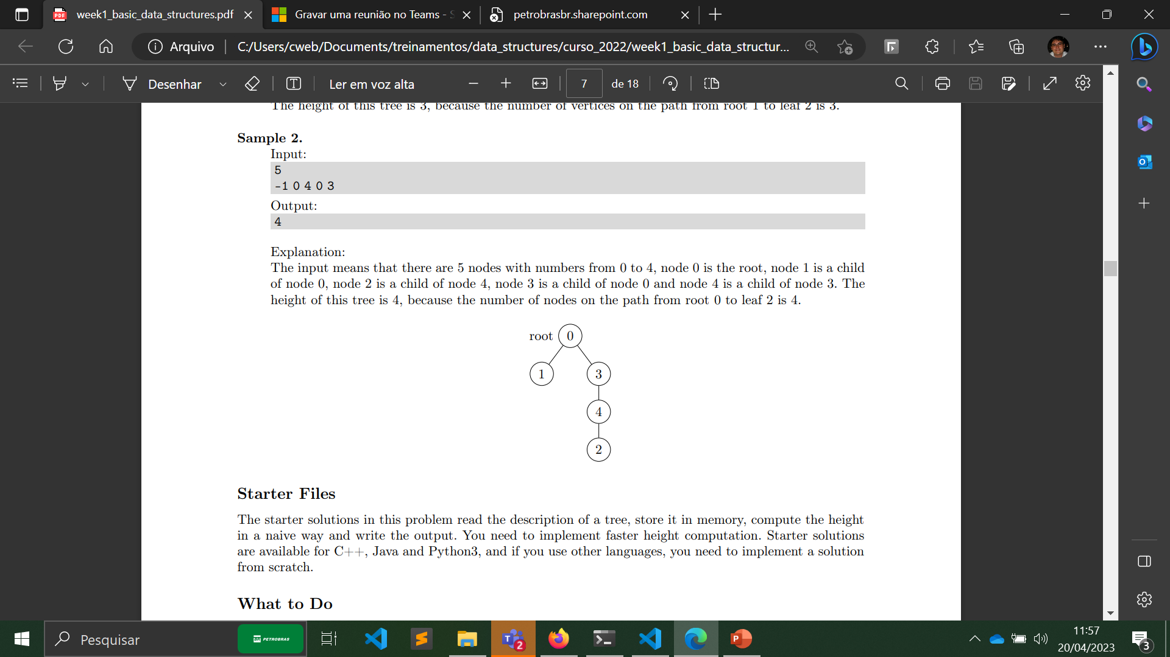
Problem 2: Compute Tree Height

Slide 8
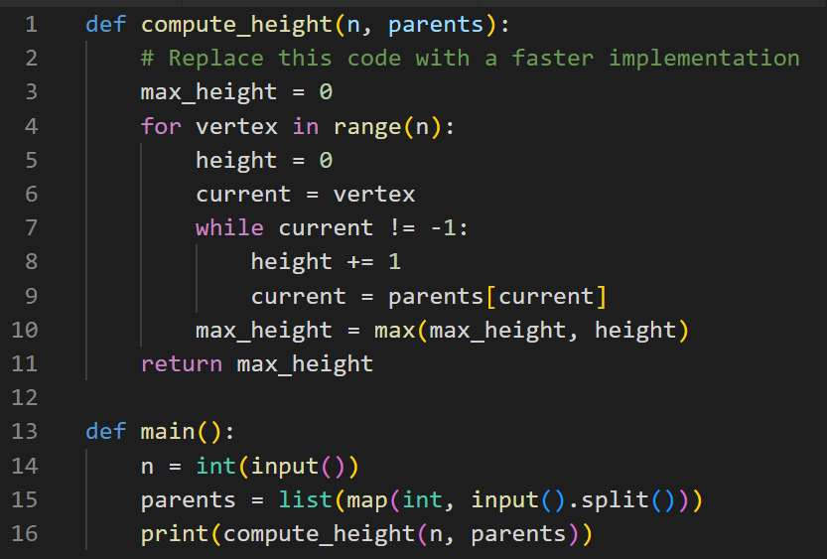
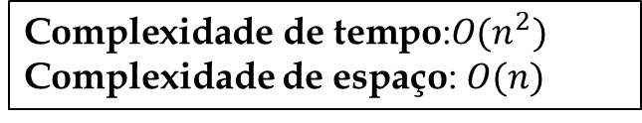
Problem 2: Compute Tree Height (Solução ineficiente)
Algoritmo (solução ineficiente)
$$\text{Complexidade} \text{de} \text{tempo}\text{:}O(n^{2})$$
Complexidade de espaço: $O(n)$

Slide 9
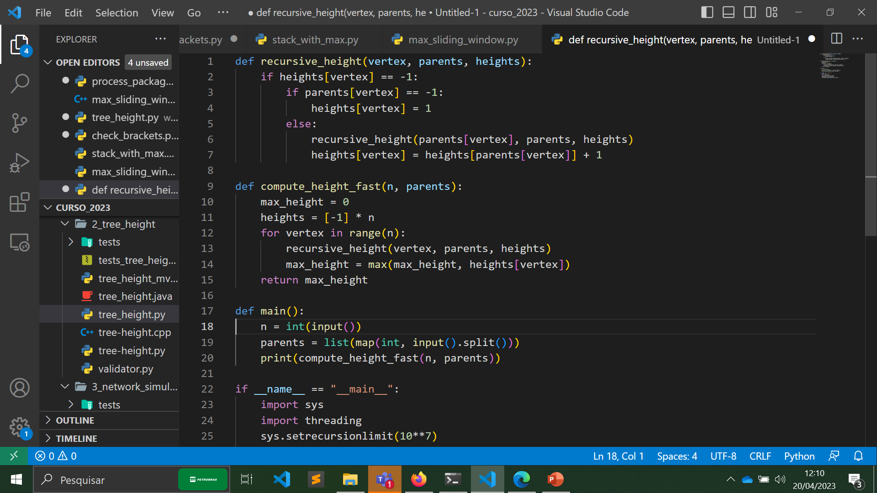
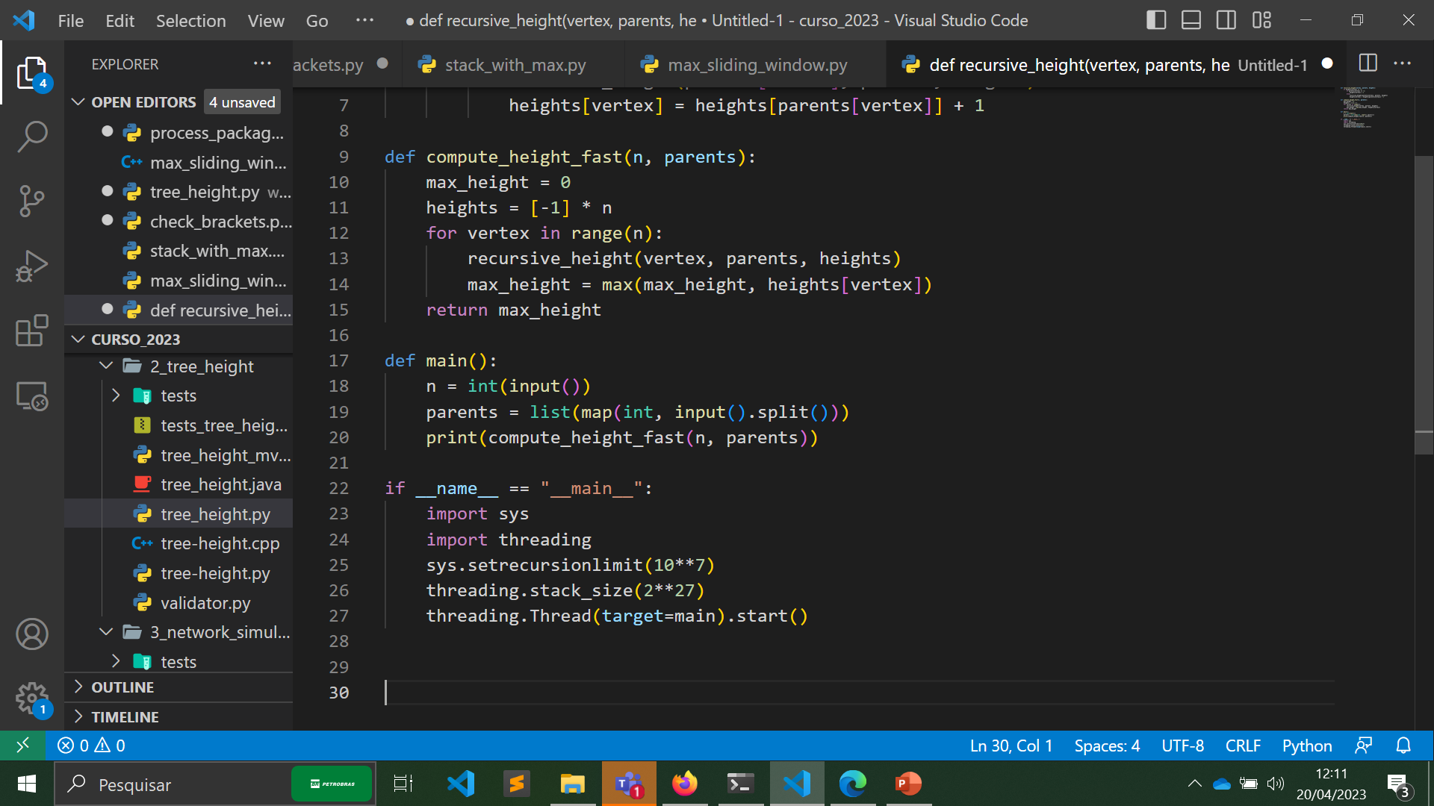
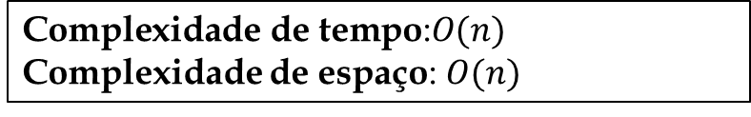
Problem 2: Compute Tree Height (Solução 1)
Algoritmo (solução eficiente usando a pilha da recursão)
Continuação
$$\text{Complexidade} \text{de} \text{tempo}\text{:}O(n)$$
Complexidade de espaço: $O(n)$

Slide 10
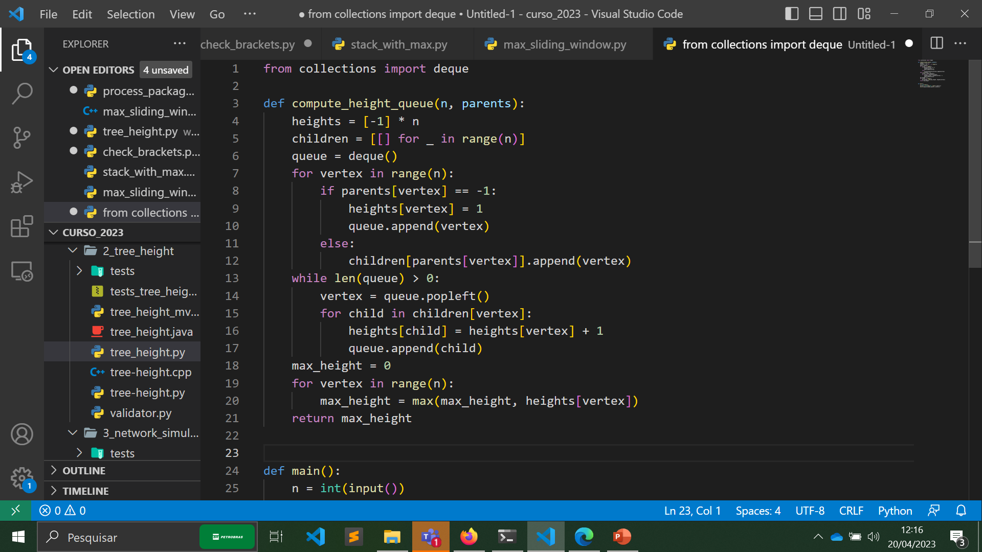
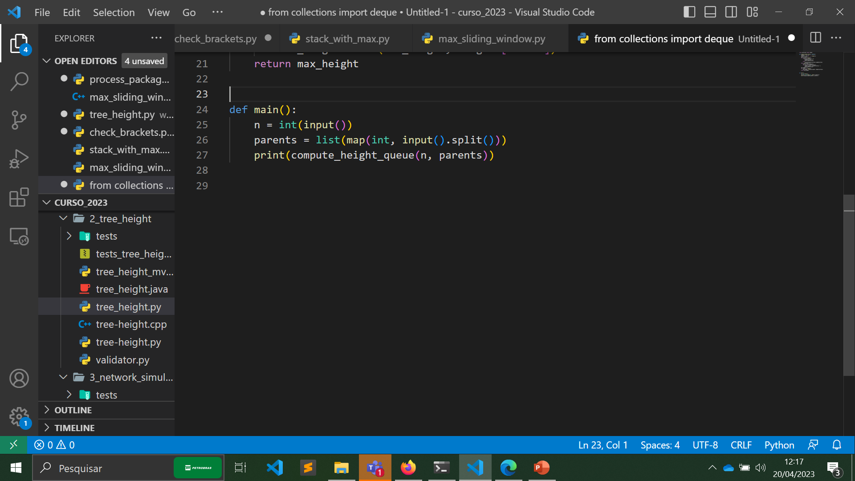
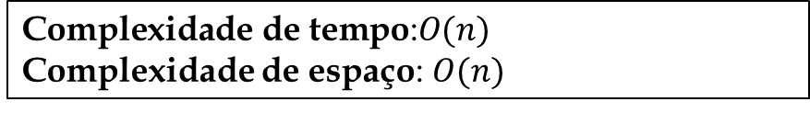
Problem 2: Compute Tree Height (Solução 2)
Algoritmo (solução eficiente usando fila)
Continuação
$$\text{Complexidade} \text{de} \text{tempo}\text{:}O(n)$$
Complexidade de espaço: $O(n)$

